Slide 1
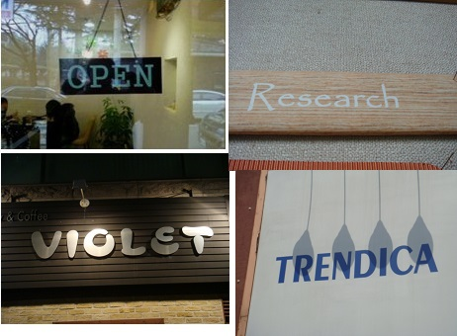


Scene Images
Text Detection
TRENDICA
Research
VIOLET
OPEN
Text Recognition
Text Binarization
Text Extracted
Scene
Images
Text Detection
Text Binarization
Text Recognition

